Slide 1
The Battle of Neighborhood
IBM Data science
Indian restaurants in toronto

Slide 2
Introduction
This is a capstone project for IBM Data Science Professional Certificate. I am developing a hypothetical scenario in this project for a concept that does not have enough Indian Restaurants in the Toronto area. So this might be a perfect opportunity for a Canadian-based entrepreneur. Since Indian food is popular among the Asian community, this entrepreneur may think about opening up his business in areas where the Asian community resides. With the intention in mind, finding the location to open such a restaurant is one of the most important decisions for this entrepreneur and I'm designing this project to help him find the most suitable place.

Slide 3
Data
We'll need below data to solve this problem:
● List of Toronto neighbourhoods, Canada
● The latitude and longitude of those districts
● Venue data concerning restaurants in India. This will help us find the neighborhoods better suited for opening an Indian Restaurant.

Slide 4
Methodology
First, I need to get the list of neighborhoods in Toronto, Canada. This is possible by extracting the list of neighborhoods from Wikipedia:
https://en.wikipedia.org/wiki/List_of_postal_codes_of_Canada:_M
scraped the site using HTML table scraping approach for pandas as pulling tabular data directly from the web is simpler and more convenient page in frame of data.
It's just a list of the community names and postal codes, though. I need to go to get their co-ordinates to use Foursquare to draw a map of locations
Near to those barrios. I tried using Geocoder to get the coordinates package but it didn't work so I used the CSV file IBM provided unit to suit community co-ordinates in Toronto. Upon reunion I imagine the Toronto map with these coordinates using the Folium kit to verify that these coordinates are right. Afterwards, I use the Foursquare API to draw a list of the top 100 venues within a radius of 500 metres.

Slide 5
Results
The results from k-means clustering show that we can categorize Toronto neighborhoods into 3 clusters based on how many Indian restaurants are in each neighborhood:
● Cluster 0: Neighborhoods with the less number of Indian restaurants.
● Cluster 1: Neighborhoods with no Indian restaurants.
● Cluster 2: Neighborhoods with a more number of Indian restaurants .
The results are visualized in the above map with Cluster 0 in green, Cluster 1 in blue, Cluster 2 in red.

Slide 6
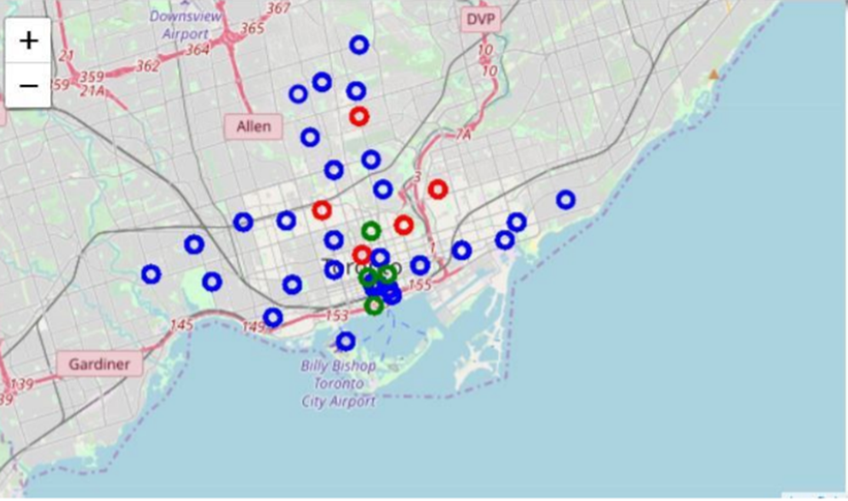
Clusters

Slide 7
Conclusion
Most of the Indian restaurants are in cluster 2 which is around
Central Bay Street, Church and Wellesley, Berczy Park, Union Station, Richmond,lowest in Cluster 1 areas which are in North Toronto West and Parkadeareas. Also, there are good opportunities to open near St James Town,Cabbagetownlooking at nearby venues it seems cluster 0 might be a good location asthere are not a lot of Indian restaurants in these areas. Therefore, this project recommends the entrepreneur to open an authentic Indian restaurant in these locations.

